Slide 1
TIME SERIES PREDICTION OF COVID-19 CASES BASED ON PEOPLE MOBILITY
Yihan Mo
Yin Xu

Slide 2
Agenda
01
Business Understanding
02
Data Understanding
03
Data Preparation
04
Modeling
05
Evaluation
05
Discussion

Slide 3
Business Understanding
Cough
Fever
Shortness Of Breath
Sore Throat
64.01 Million
Infected Cases Worldwide
People are in close contact with one another (within about 6 feet)
Droplets can land in the mouths or noses of people who are nearby or possibly be inhaled into the lungs
Droplets can also land on surfaces and objects that have virus on them
Droplets and airborne particles that are formed when a person who has COVID-19 coughs, sneezes, sings, talks, or breathes
How virus spread:
1.48 Million
Deaths Worldwide

Slide 4
Business Understanding
PANDEMIC
How To Prevent An Outbreak
Stay at home
Social Distance
Wear masks
Self quarantine for > 14 days after traveling

Slide 5
Literature Review
Author | Sample | Title | Summary
Oztig and Askin (2020) | Airline passengers carried across the 144 countries | Human mobility and coronavirus disease 2019 (COVID-19): A negative binomial regression analysis | A relationship between the massive scale of human mobility among intensive airline travel and the Covid-19 infected case amount in corresponding countries Limitation: measuring people’s mobility only using the number of the passenger during air travel
Cartenì, A., Di Francesco, L., & Martino, M. (2020) | 1200 car traffic count automatic sensor data from the Italian Transport Ministry from January 2020 to May 2020 | How mobility habits influenced the spread of the COVID-19 pandemic: Results from the Italian case study | A multiple linear regression model shows that the correlations between people's frequent mobility and increasing contagious cases with an around 21-day threshold between peaks of people’s movement and Covid-19 positive cases occurred in Italy Limitation: Neglect potential impact of other moderator factors

Slide 6
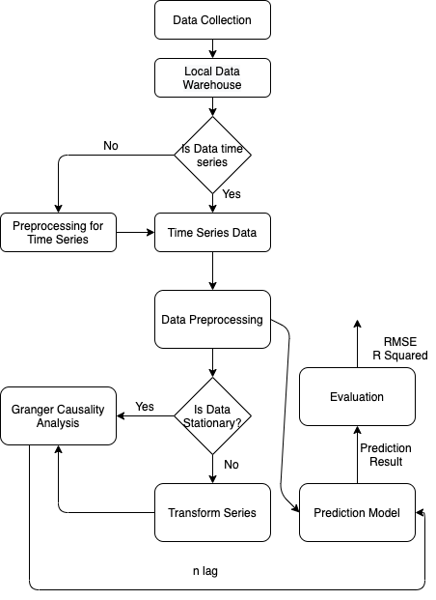
Analytical Framework
Data Collection
Collects Public Data
Data Preprocessing
Transforms Series
Replace Missing Value
Modeling
Granger Causality
Prediction Model
Figure 1: Analytics Process

Slide 7
Data Understanding
People Mobility Data:
Restaurants Reserve (OpenTable Restaurant Reservation information)
Public Traffic Accident Record (Motor Vehicle Crashes)
Covid-19 Cases Data:
United States COVID-19 Cases and Deaths by State over Time (CDC)
Data Source:
Traffic Crash Report provided by Florida Highway Safety
Motor Vehicle Collision Crashes offered by NYC Police Department Open Data
Traffic Collision Data recorded by LA Police Department
Score of the searching keyword 'mask' is used as an indicator of people's willingness to wear face masks from February to September shown by Google Trend
Real-time Covid-19 Cases recorded by the Center for Disease Control and Prevention

Slide 8
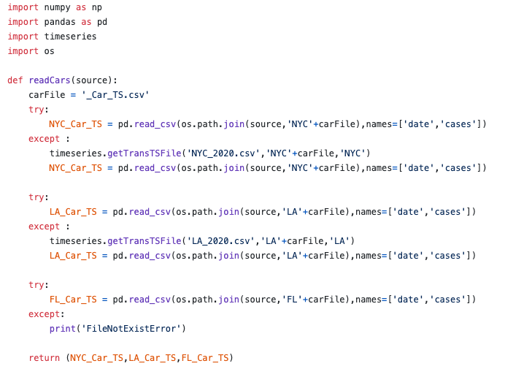
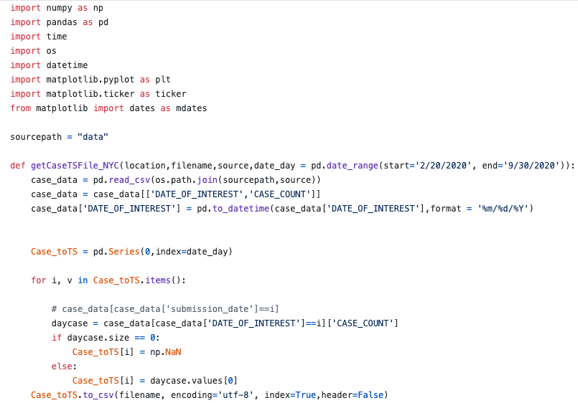
Data Preparation
Feature Selection
Data Fusion
Time Series Convert
Preprocessing
Read in raw data from CSV files, if the time series data exist, read in the time series data, else generate time series data from the raw data
Generate time series data from the raw data, transfer the raw data into time series data.

Slide 9
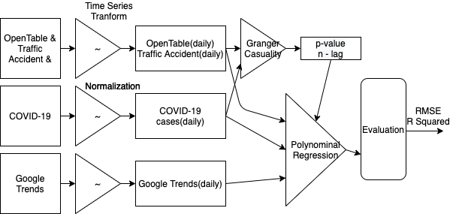
Modeling Workflow Overview
1
2
3

Slide 10
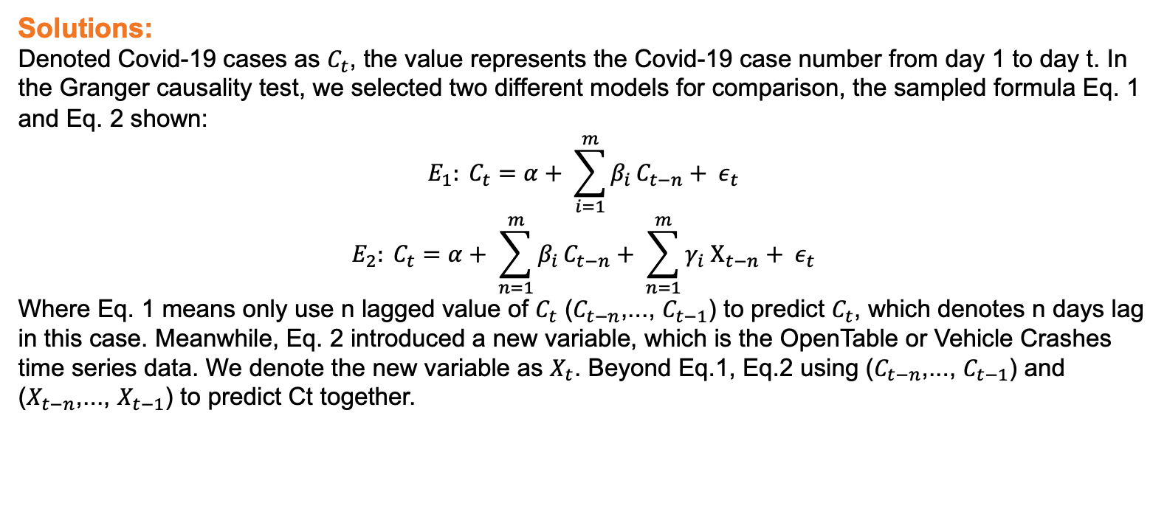
Bivariate Granger Causality Analysis
Aims to answer following questions:
1) Whether OpenTable restaurant reservation or car crashes data can serve as predictors to the Covid-19 cases or not?
2) What is the time lag of prediction using OpenTable restaurant reservation or car crashes data as predictors to predict the Covid-19 cases?
Solutions:
Denoted Covid-19 cases as $C_{t}$, the value represents the Covid-19 case number from day 1 to day t. In the Granger causality test, we selected two different models for comparison, the sampled formula Eq. 1 and Eq. 2 shown:
$$E_{1}: C_{t}=α+ \sum_{i=1}^{m}{β_{i }C_{t−n}+ ε_{t}}$$
$$E_{2}: C_{t}=α+ \sum_{n=1}^{m}{β_{i }C_{t−n}+ \sum_{n=1}^{m}{γ_{i}}{ Χ_{t−n}+ ε}_{t}}$$
Where Eq. 1 means only use n lagged value of $C_{t}$ ($C_{t−n}$,..., $C_{t−1}$) to predict $C_{t}$, which denotes n days lag in this case. Meanwhile, Eq. 2 introduced a new variable, which is the OpenTable or Vehicle Crashes time series data. We denote the new variable as $X_{t}$. Beyond Eq.1, Eq.2 using ($C_{t−n}$,..., $C_{t−1}$) and ($X_{t−n}$,..., $X_{t−1}$) to predict Ct together.

Slide 11
Bivariate Granger Causality Result
Lag of OpenTable vs Covid-19 Cases
lag/days | NYC | FL | LA
18 | 0.0000** | 0.0154** | 0.0993*
19 | 0.0000** | 0.0065** | 0.0446**
20 | 0.0015** | 0.0137** | 0.0075**
21 | 0.0003** | 0.0014** | 0.0074**
22 | 0.0003** | 0.0015** | 0.0042**
The OpenTable has a Granger Causality relation with Covid-19 cases with lags ranging from 19-22 days in all three areas. (We select 21 days as a result)
The car crashes has a Granger Causality relation with Covid-19 cases with lags in 16 days in all three areas.
Lag of Car Crashes vs Covid-19 Cases
lag/days | NYC | FL | LA
15 | 0.0001** | 0.1661 | 0.1661
16 | 0.0020** | 0.0262** | 0.0384**
17 | 0.0027** | 0.0414** | 0.1096
18 | 0.0023** | 0.0618* | 0.1372
19 | 0.0081** | 0.0852* | 0.1611

Slide 12
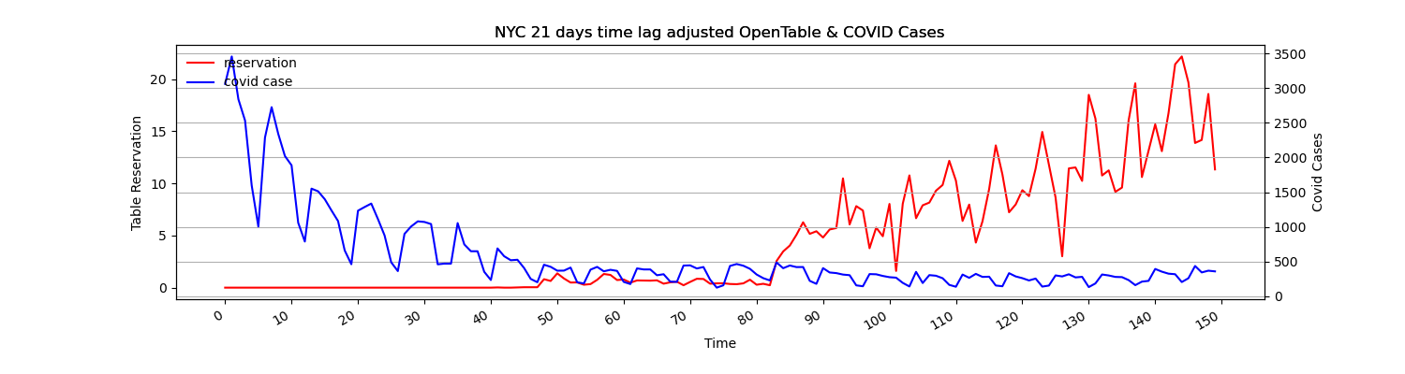
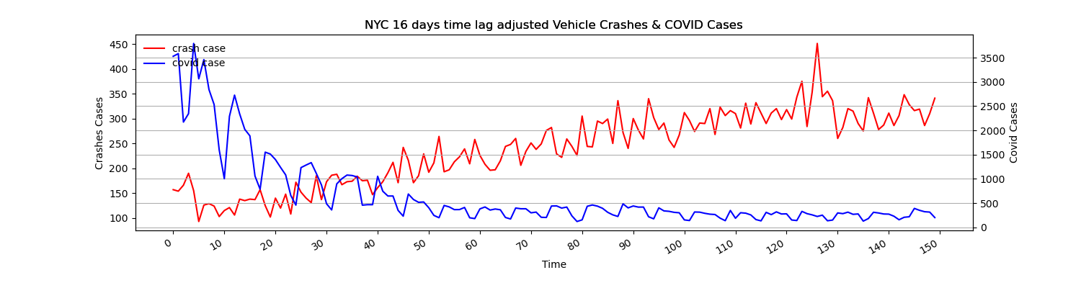
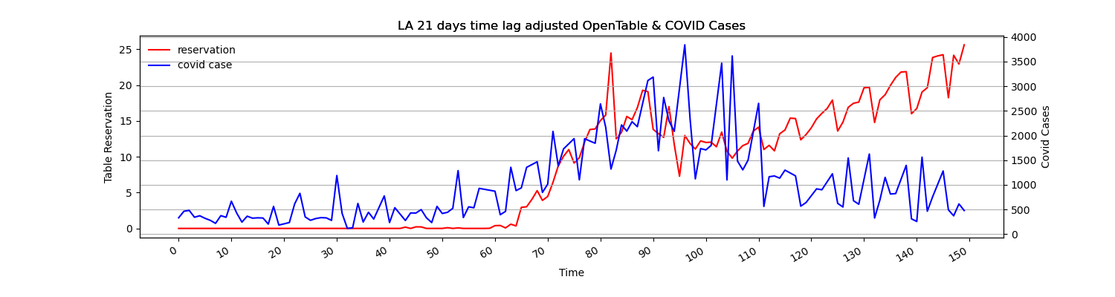
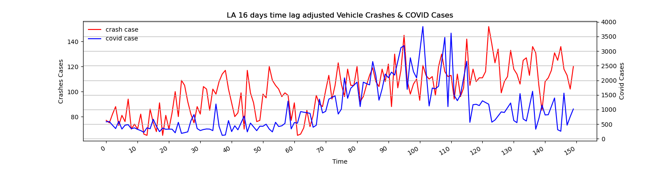
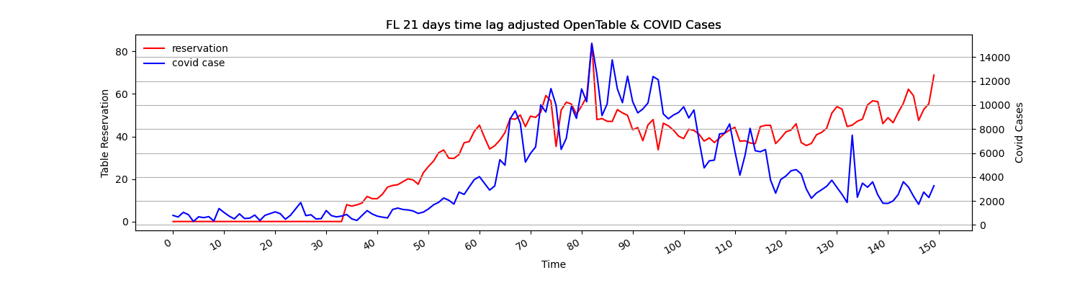
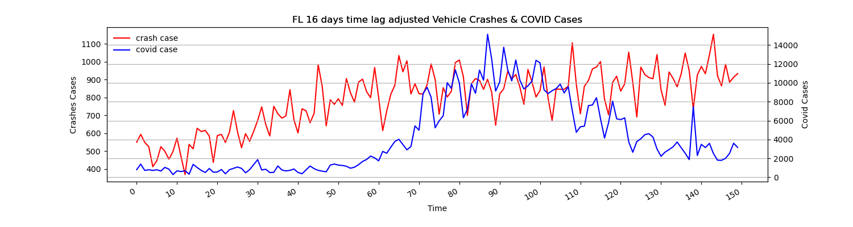
Granger Causality Visualization Results
Figure 3 : OpenTable vs COVID-19 Cases (lag = 21)
Figure 4 : Traffic Accident vs COVID-19 Cases (lag = 16)
Date Start Since April 1st.

Slide 13
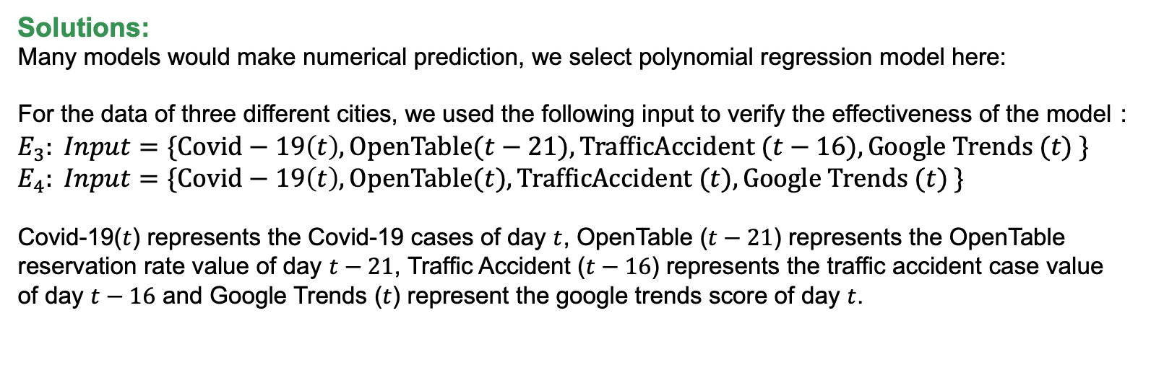
Polynomial Model for Covid-19 Cases Prediction
Shortcomings
Granger causality analysis is based on linear regression, and from the results of data visualization, we can easily find that the trends of OpenTable, traffic accidents, and Covid-19 are all non-linear
Granger causality analysis can verify the correlation between variables, but it cannot make numerical predictions.
Solutions:
Many models would make numerical prediction, we select polynomial regression model here:
For the data of three different cities, we used the following input to verify the effectiveness of the model：$E_{3}: Input=\{Covid−19\left(t\right),OpenTable(t−21), TrafficAccident (t−16), Google Trends (t) \}$
$$E_{4}: Input=\{Covid−19\left(t\right),OpenTable(t), TrafficAccident (t), Google Trends (t) \}$$
Covid-19($t$) represents the Covid-19 cases of day $t$, OpenTable ($t−21$) represents the OpenTable reservation rate value of day $t−21$, Traffic Accident ($t−16$) represents the traffic accident case value of day $t−16$ and Google Trends ($t$) represent the google trends score of day $t$.

Slide 14
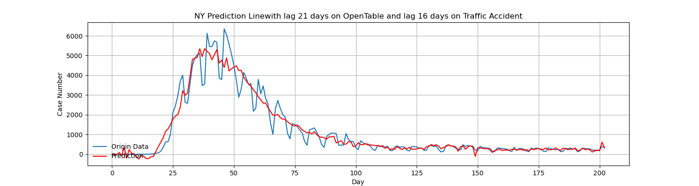
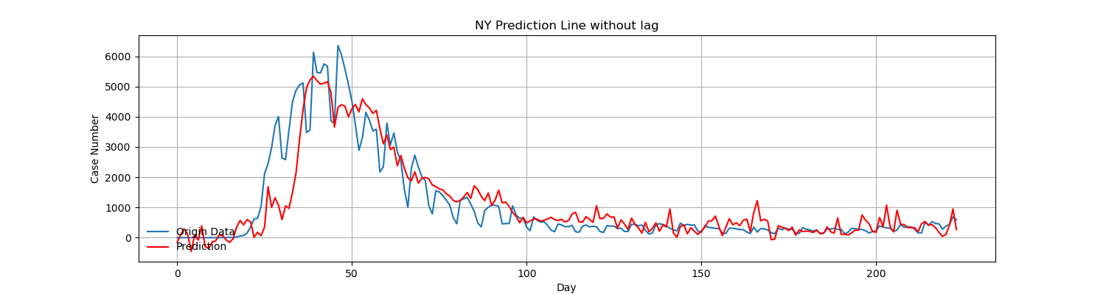
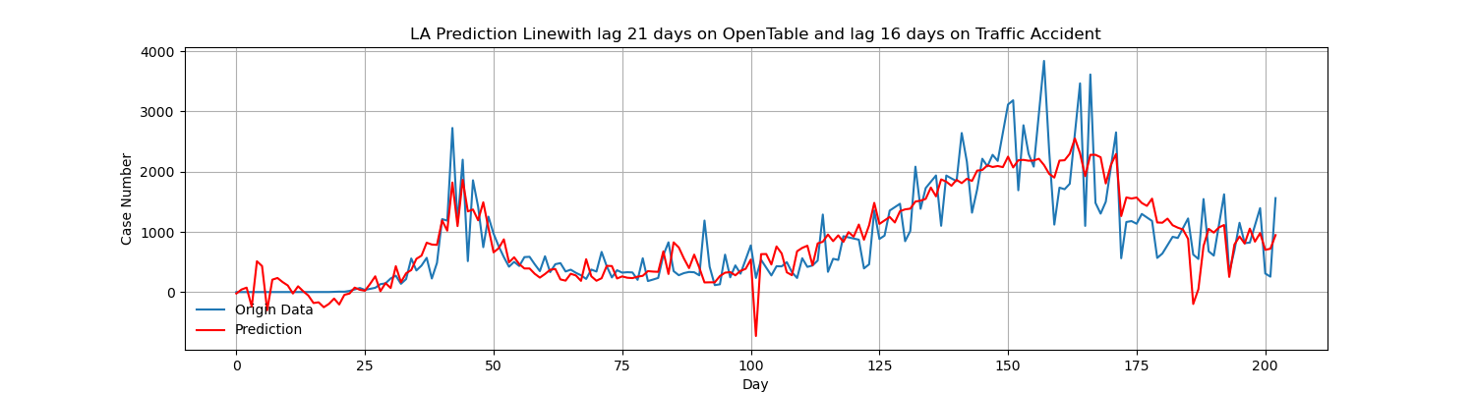
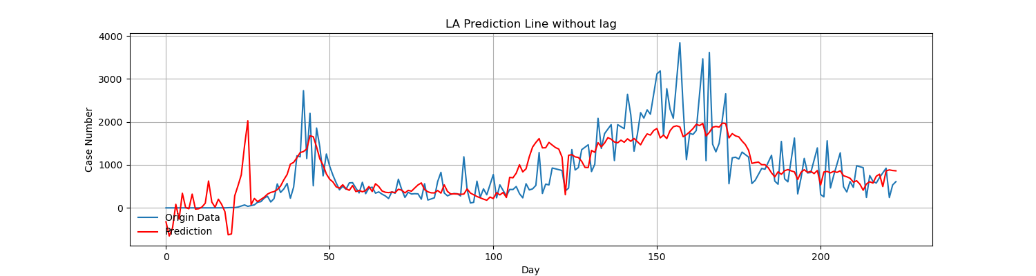
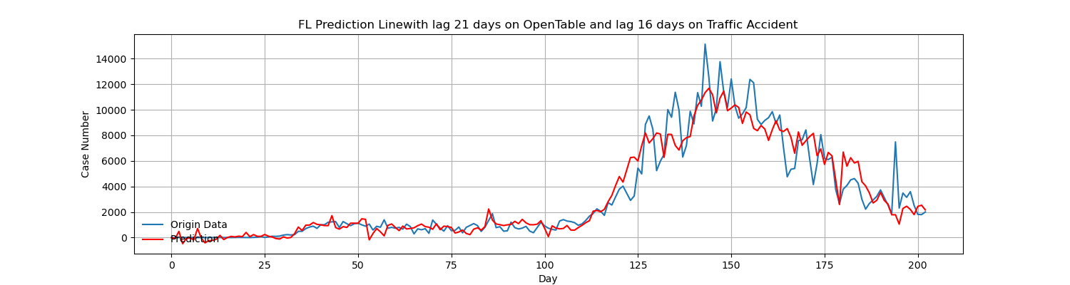
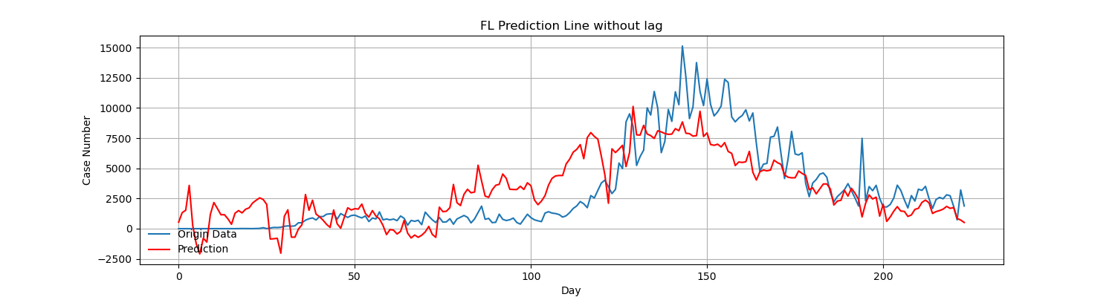
Polynomial Model Prediction Results
Figure 5: Prediction with 21-day lag on OpenTable and 16-day lag on Vehicle Crashes
Figure 6: Prediction without lag on OpenTable and Vehicle Crashes
Date Start Since February 20th.

Slide 15
Evaluation
Table 3: Evaluation Result for model with and Without Lag
 |  | With Time Lag |  |  | Without Time Lag
Cities |  | REMS | R² |  | REMS | R²
NYC | Training Set | 417.87 | 0.925 |  | 681.40 | 0.803
 | Testing Set | 590.89 | 0.897 |  | 727.21 | 0.620
LA | Training Set | 457.320 | 0.663 |  | 516.961 | 0.579
 | Testing Set | 549.687 | 0.702 |  | 484.90 | 0.456
FL | Training Set | 1384.488 | 0.861 |  | 2237.962 | 0.596
 | Testing Set | 1183.600 | 0.701 |  | 2758.685 | 0.353
Evaluation Measure
The root mean squared error (RMSE)
R squared (R²)
NYC
LA
FL

Slide 16
Evaluation
Figure 6: NYC Prediction with lag vs Original Data
Conclusions:
The time lag between Covid-19 cases and traffic accident cases and the time lag between Covid-19 cases and OpenTable reservation rate, improves the prediction accuracy of the polynomial model of predicting Covid-19 cases.
Figure 7: LA Prediction with lag vs Original Data
Figure 8: FL Prediction with lag vs Original Data

Slide 17
Discussion & Conclusion
Data Support
Data Integrity
For further research on predict Covid-19 or other infectious diseases with similar spread features
Even though government publish the data, it comes from active testing and reporting. Obtaining the actual number of infections is still a challenge.
Research Insight
Data Amount
Generate a timeline of how diseases spread and provide actionable suggestions for the public or government to conduct precautionary measures
A small volume of data might limit the accuracy of the prediction model . The option of modeling also limited by the data volume.
Applied Prediction
Other Related Variables
Explore possible predictive analytics method to figure out solutions for real-world problem.
Other moderator variables that affect the spread of diseases, such as pollution density, prevention measures, unpredictable gathering events, integration frequency.

Slide 18
THANK YOU

